Slide 1
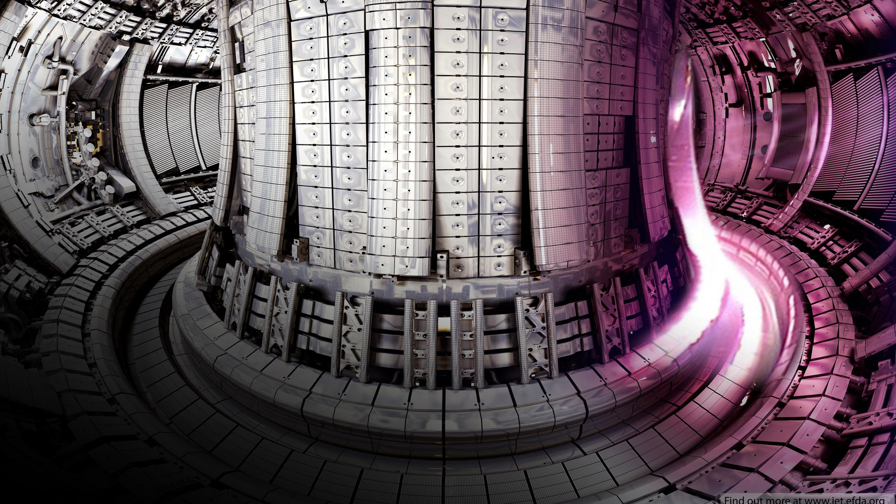
Optimising Tritium Production in Fusion Breeder Blankets
VADAN KHAN AND RHODRI PETERS
SEMESTER 1 MASTERS PRESENTATION

Slide 2
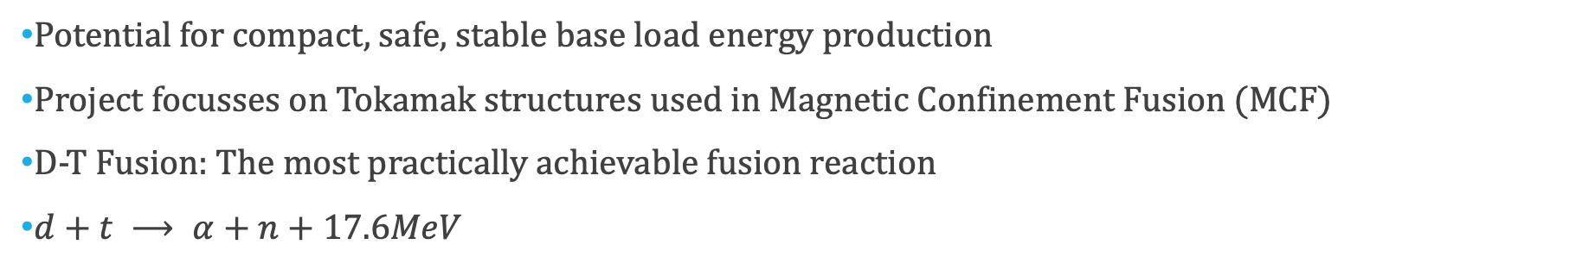
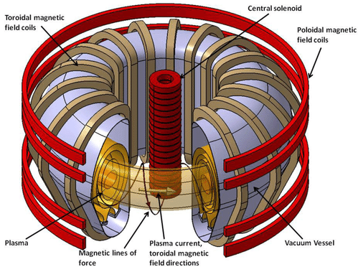
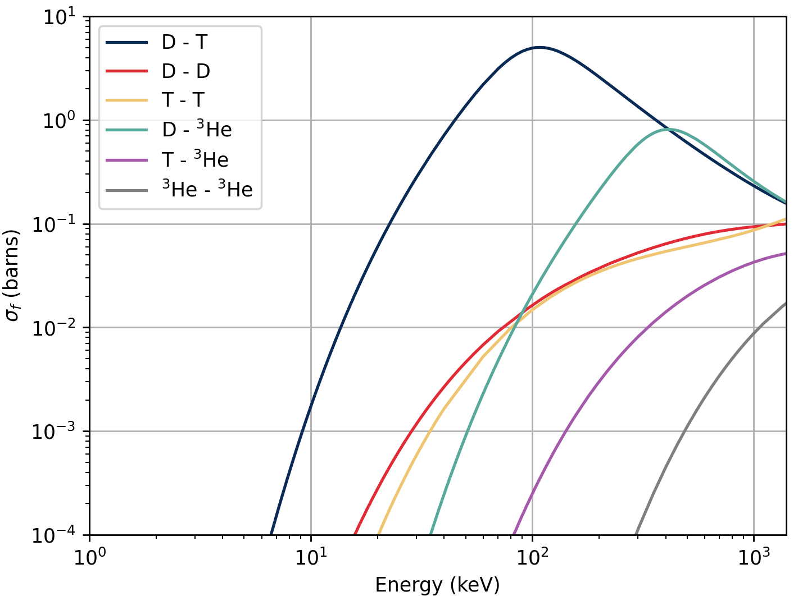
Introduction to Fusion

Slide 3
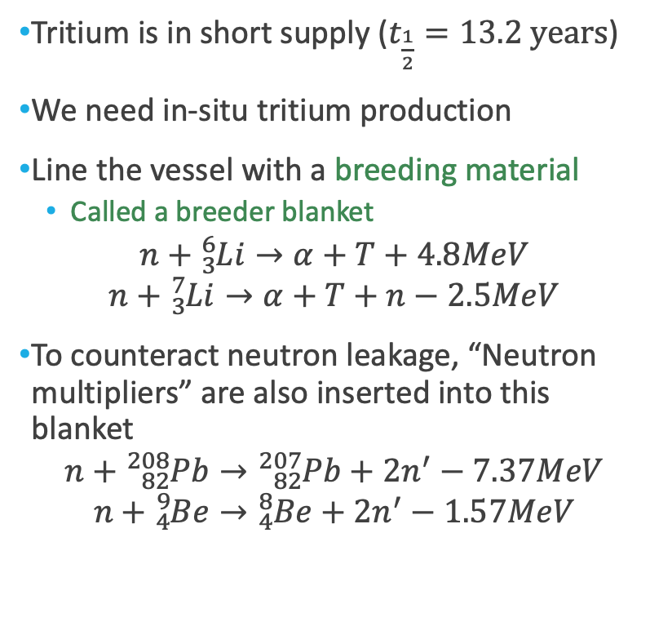
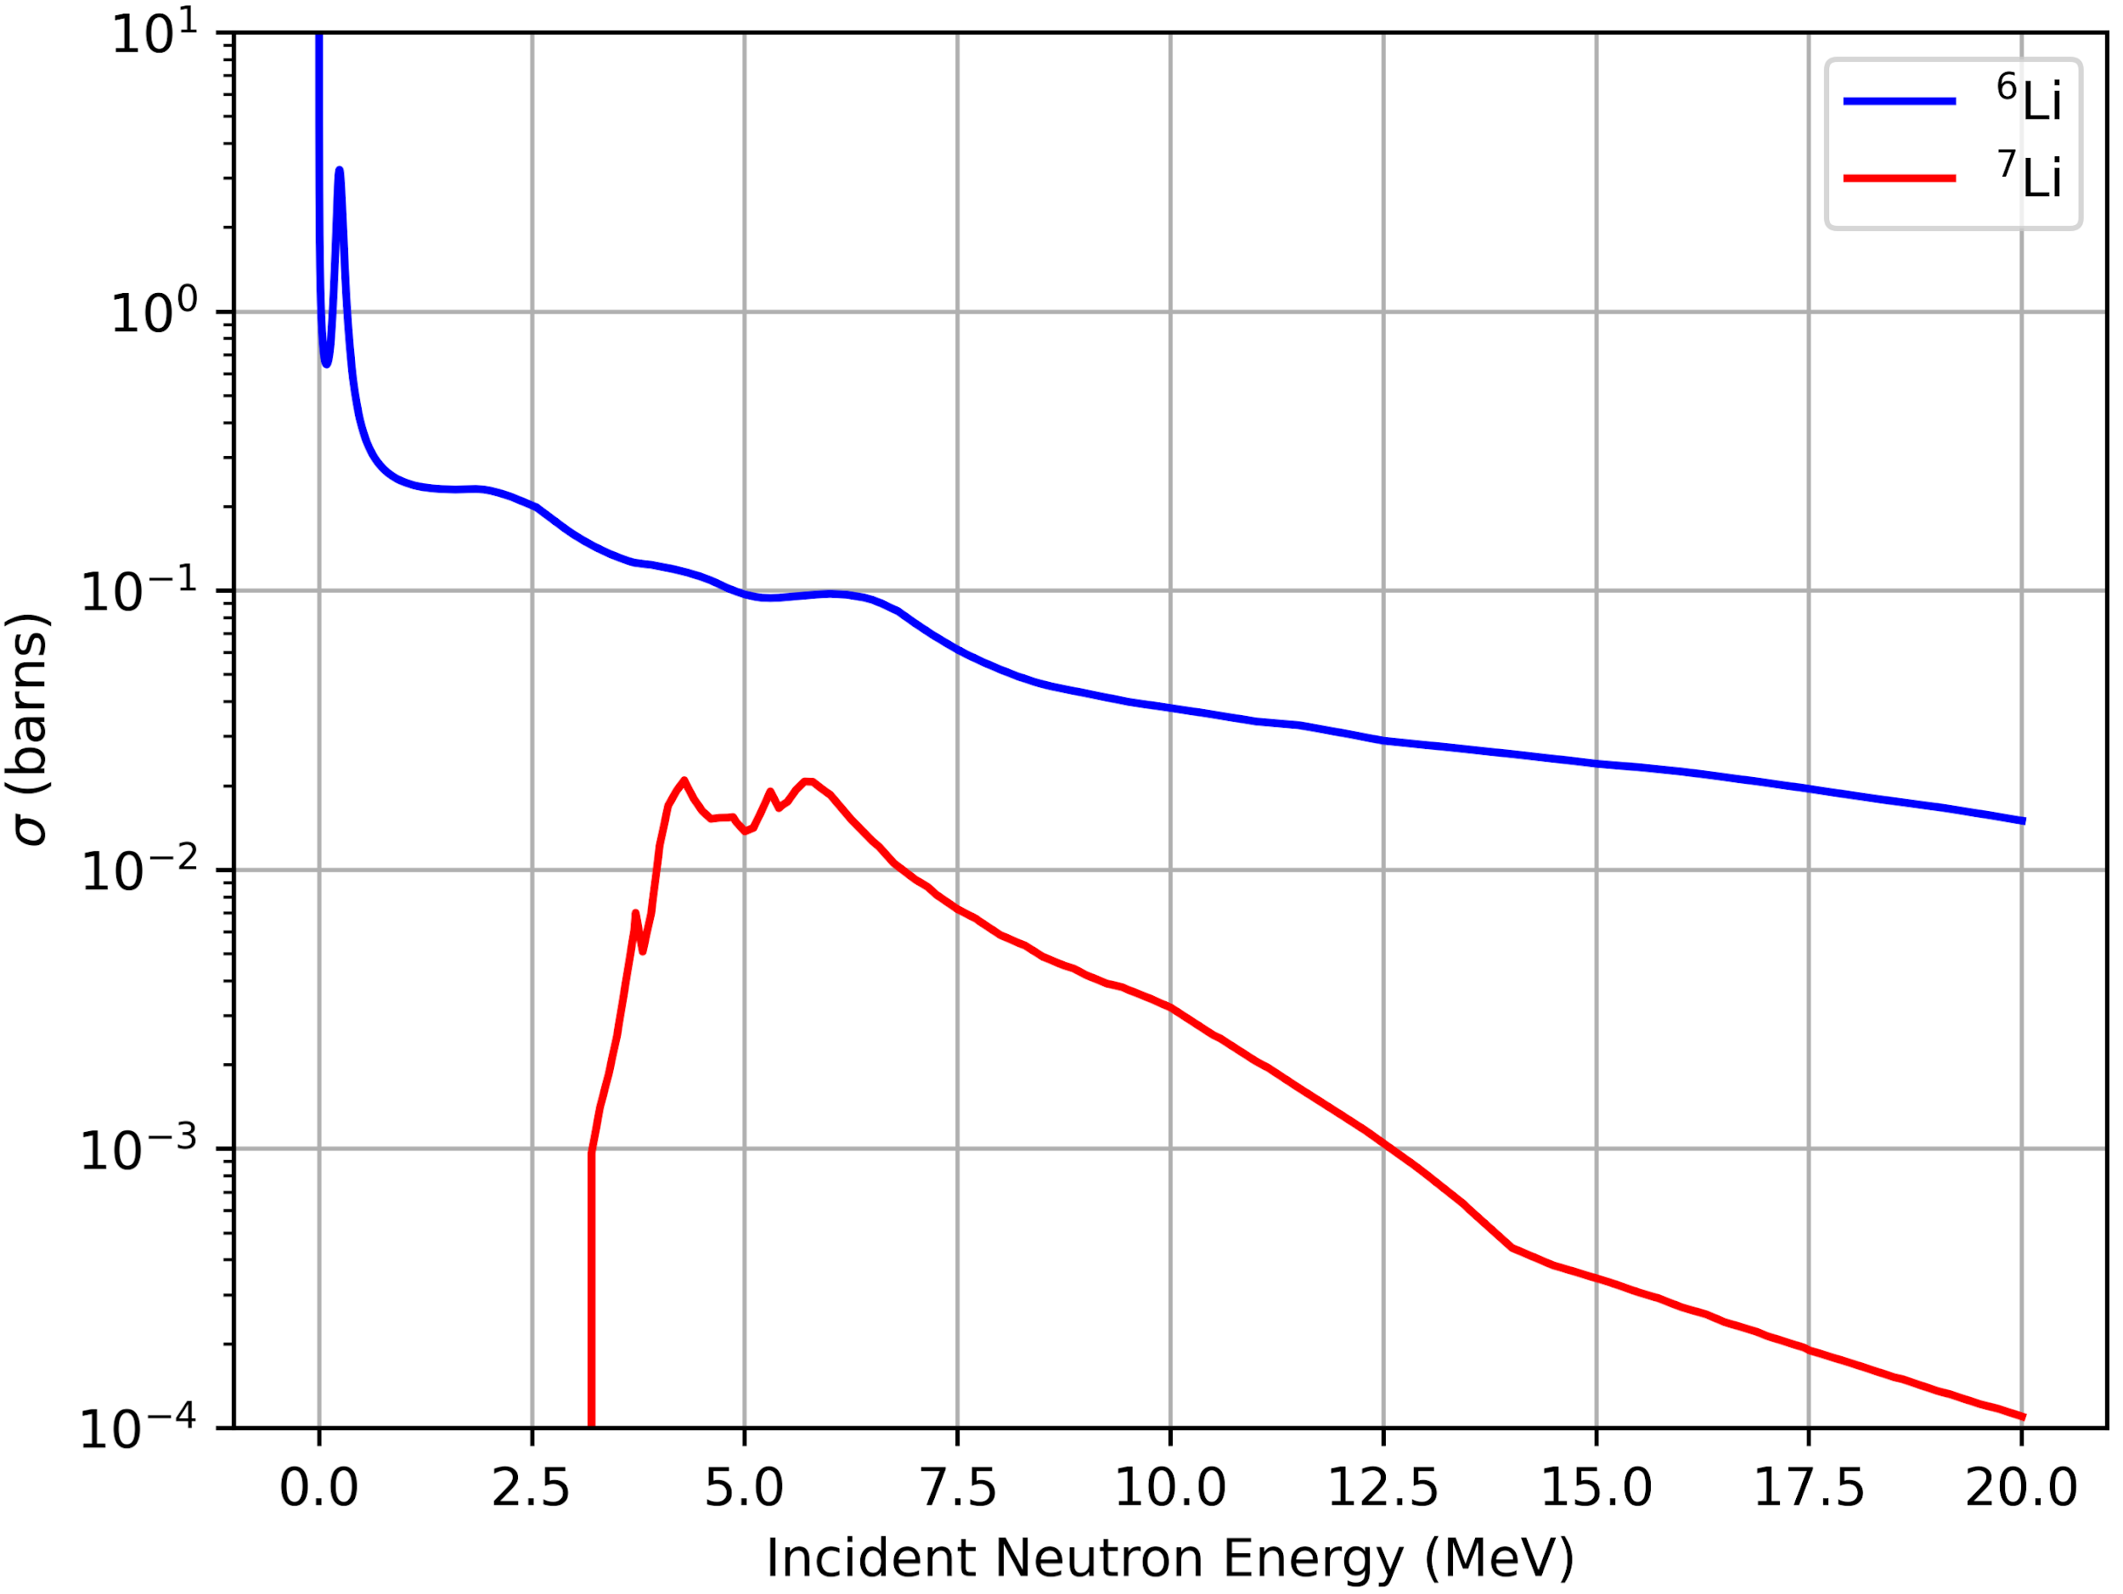
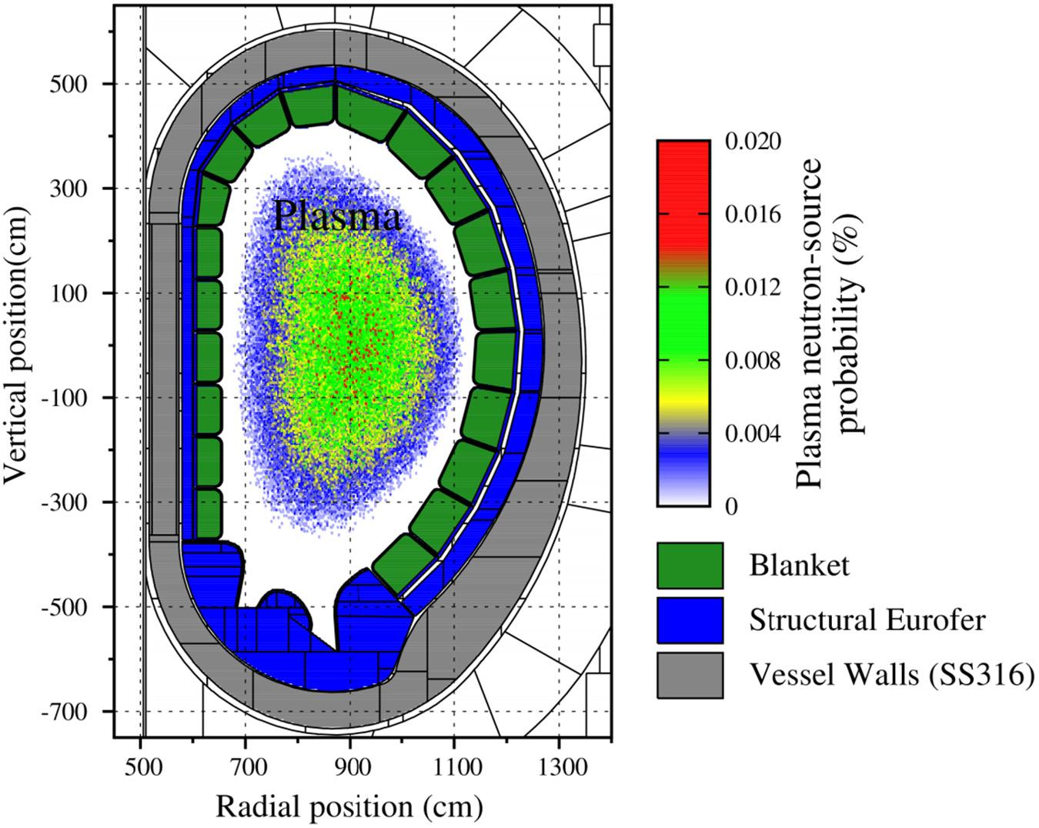
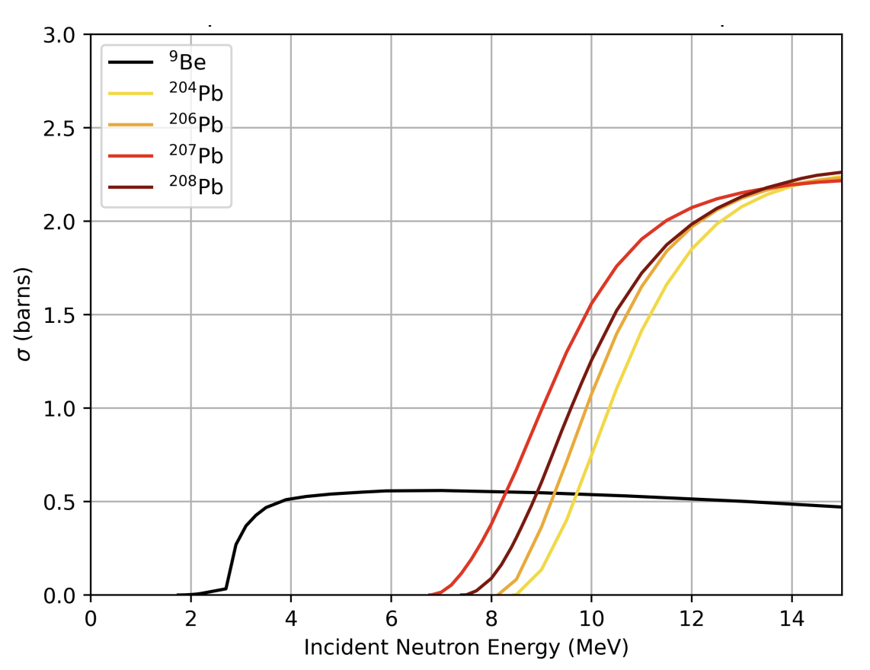
Breeder Blankets

Slide 4
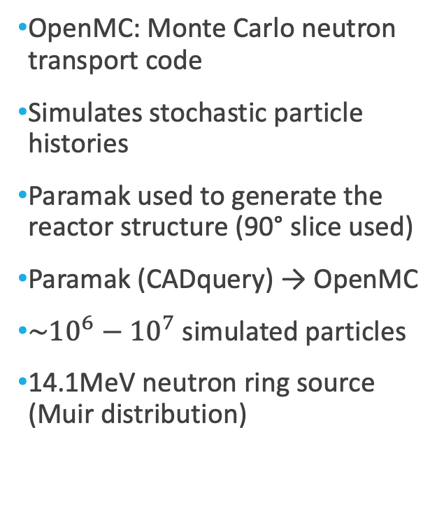
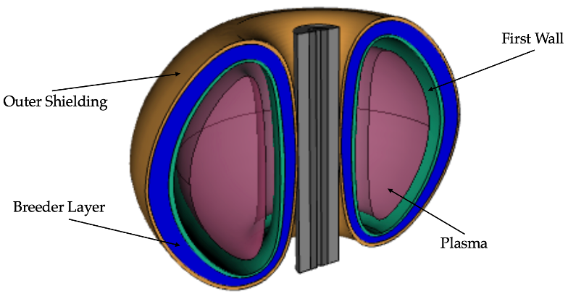
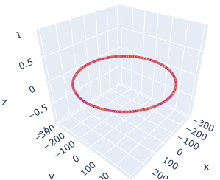

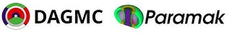
OpenMC and Simulation

Slide 5
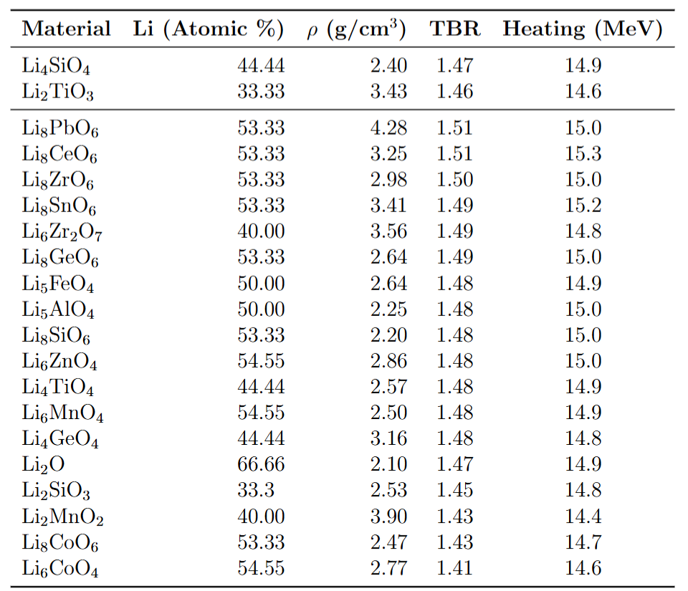
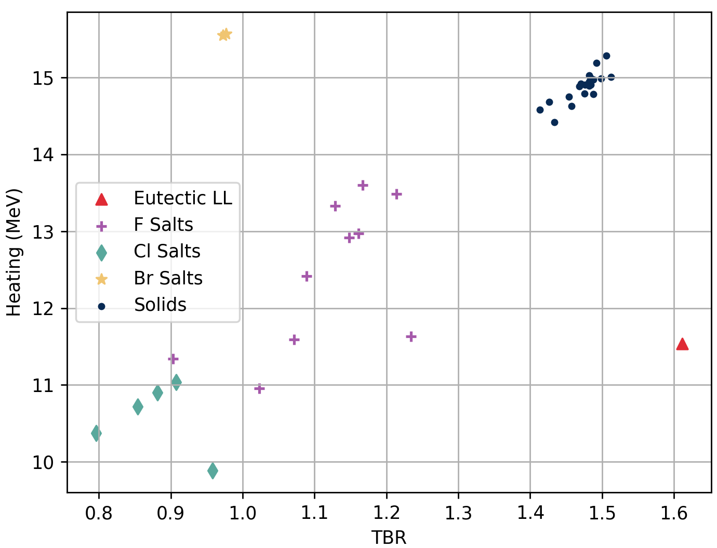
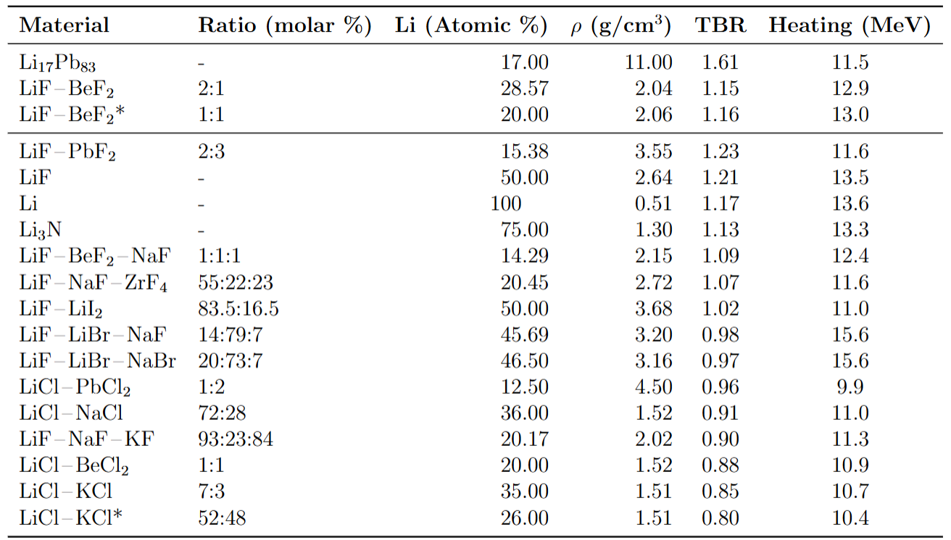
Liquid and Solid Breeder Materials

Slide 6
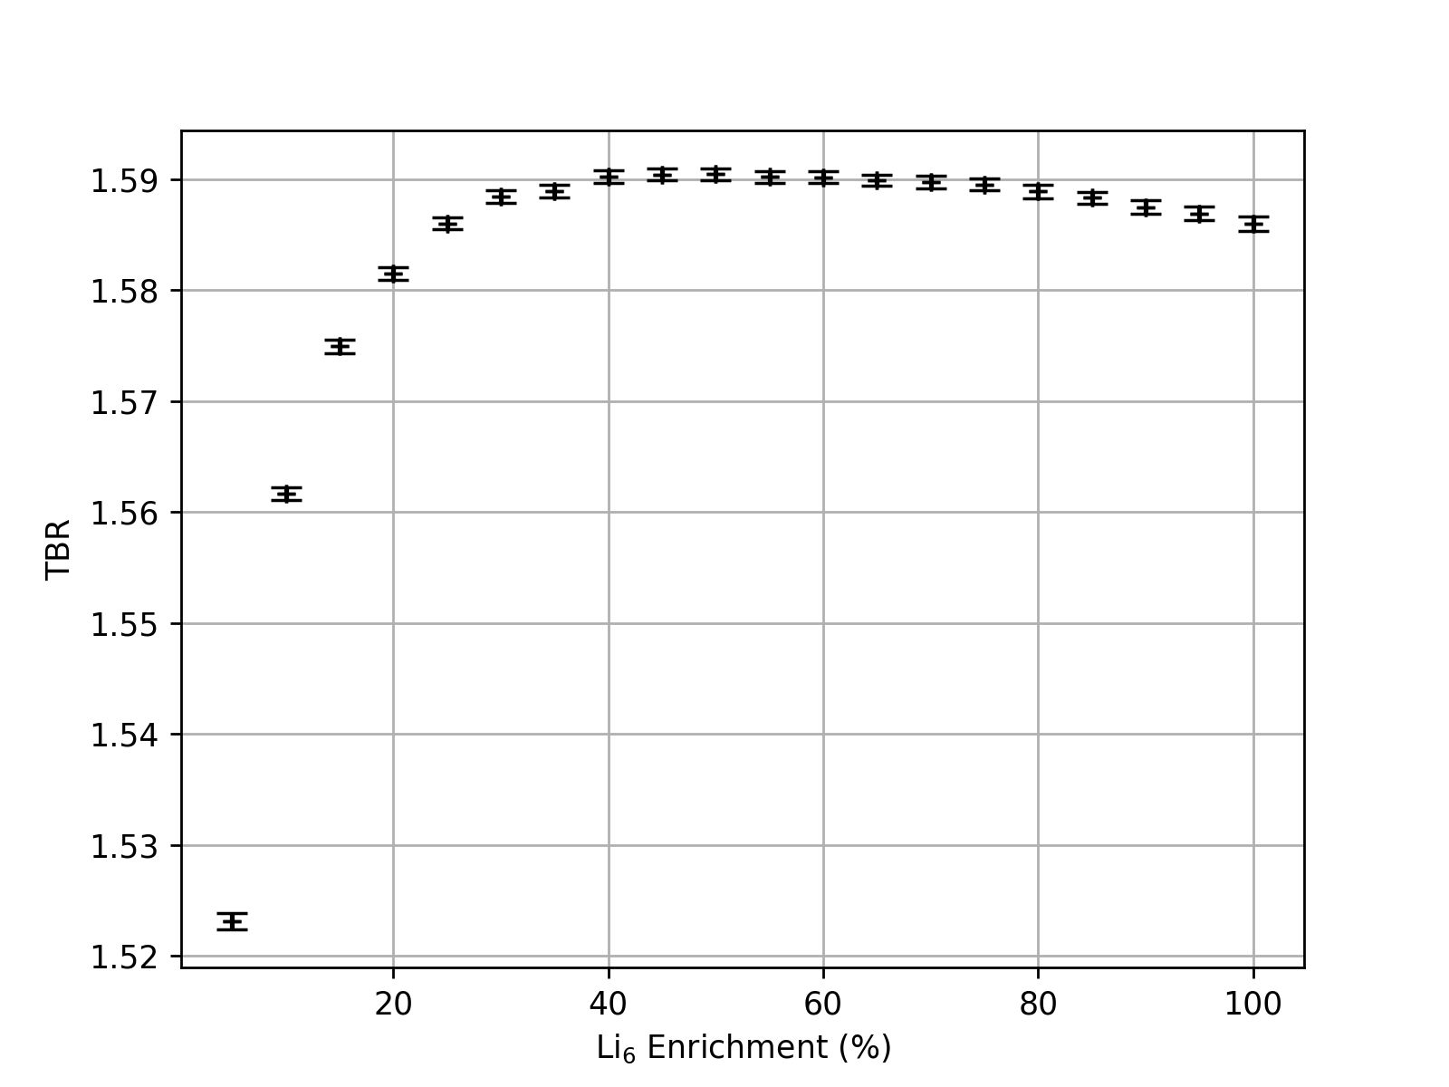
Lithium-6 Enrichment
Literature Values on Enrichment Vary from 40 - 90%
Our study suggests a saturation at 40%
Even 20 - 30 % could still be suitable as a compromise on expensive enrichment costs

Slide 7
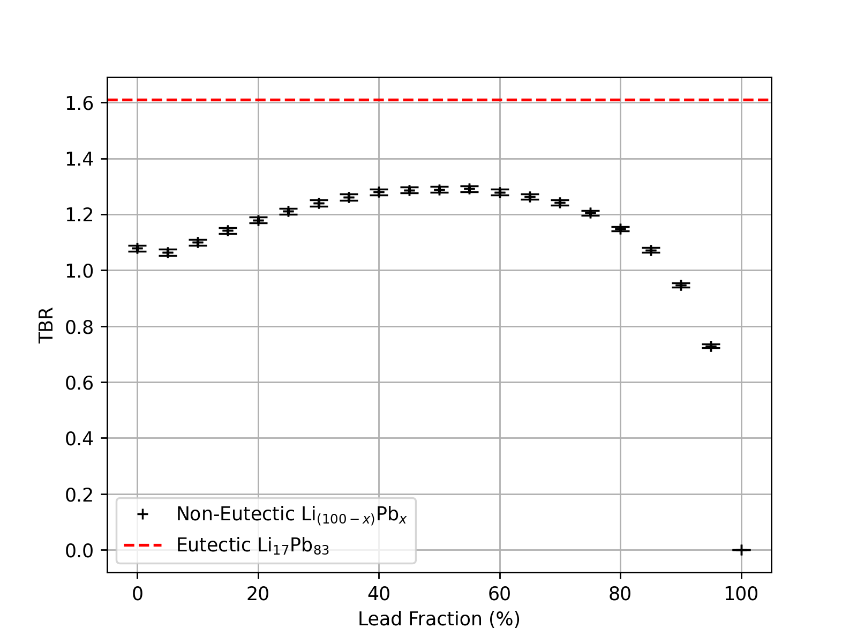
Lithium-Lead Multiplier Ratio
Foundational study assuming non-varying packing factors
Eutectic LiPb Alloy resulted in far higher TBR
Mostly due to its higher density
Demonstrates the significance of packing factors and alloy density

Slide 8
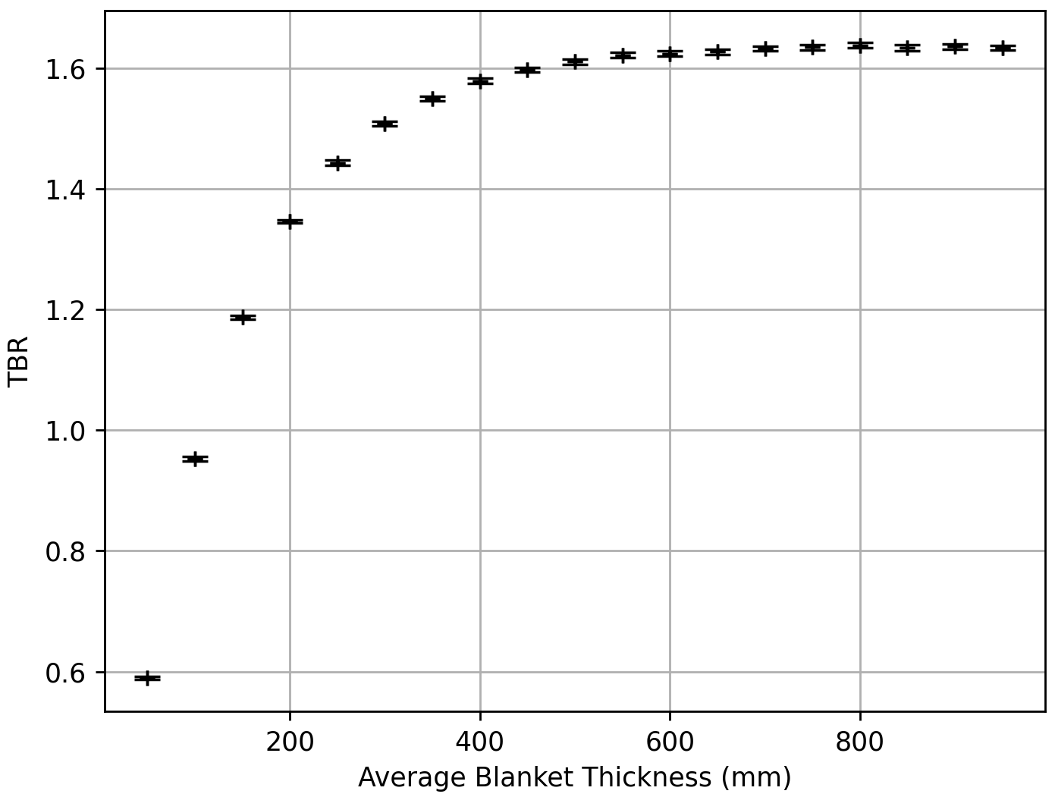
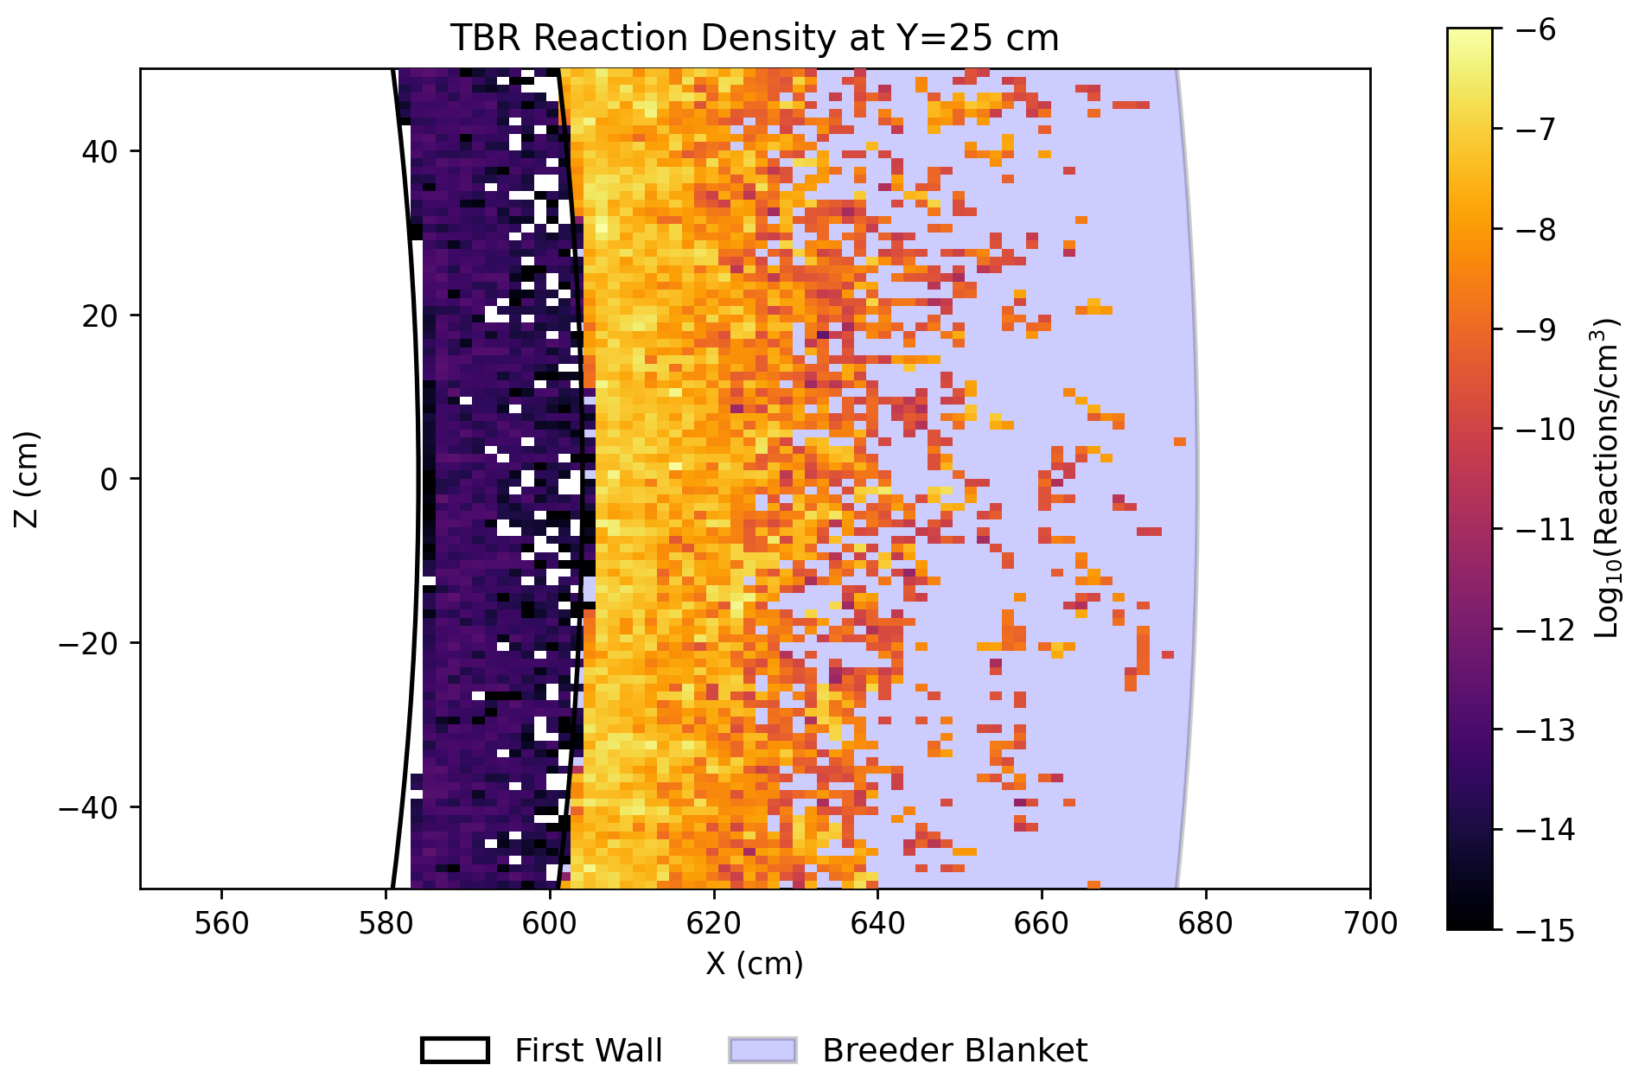
Breeder Blanket Thickness
TBR / BLANKET THICKNESS
TBR REACTION HEATMAP

Slide 9
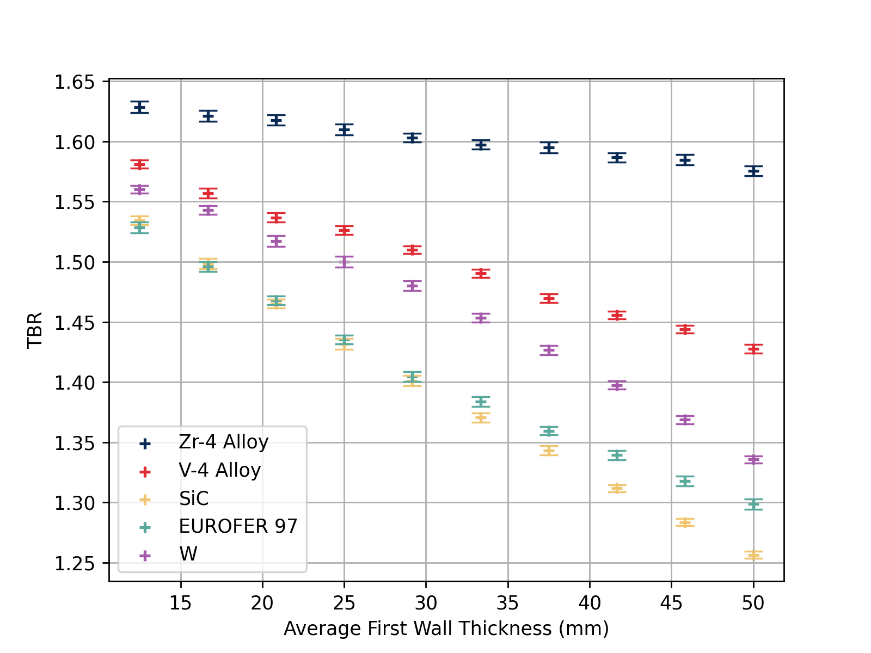
First Wall Thickness
Considering TBR alone, the zirconium alloy is far superior
Max thermal flux limit & plasma parameters could influence this choice in a real device

Slide 10
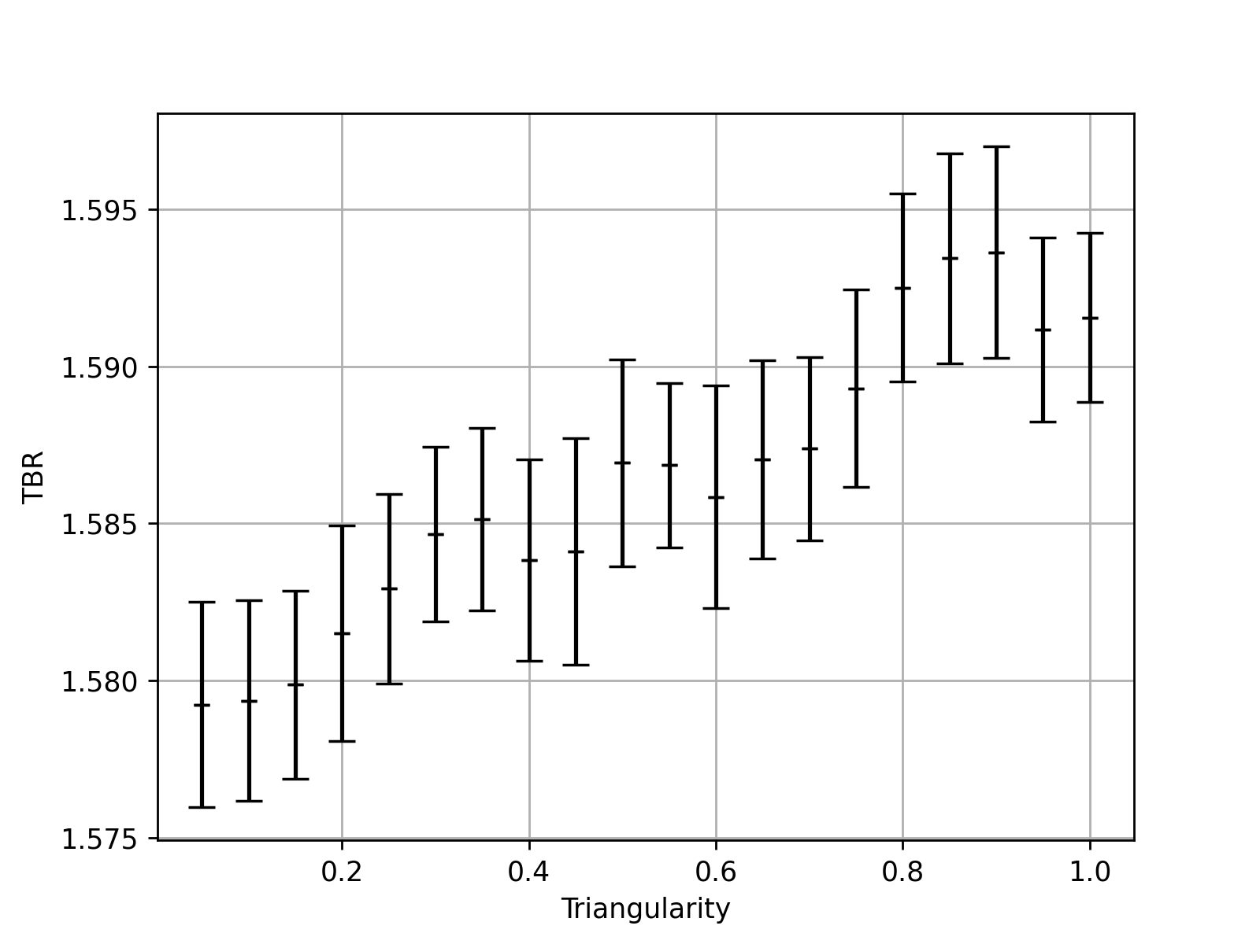
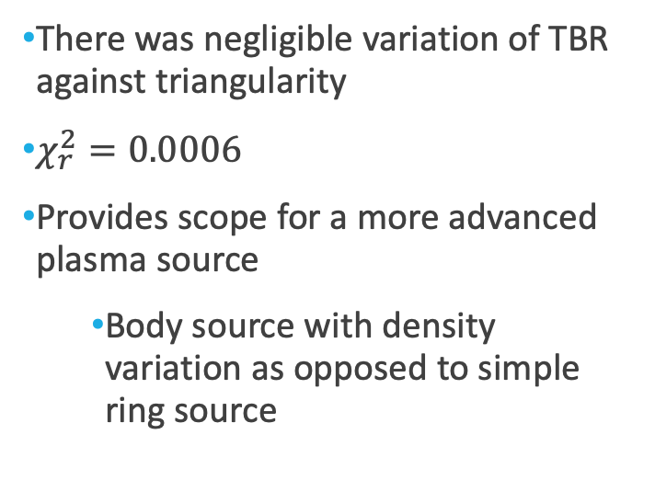
Triangularity

Slide 11
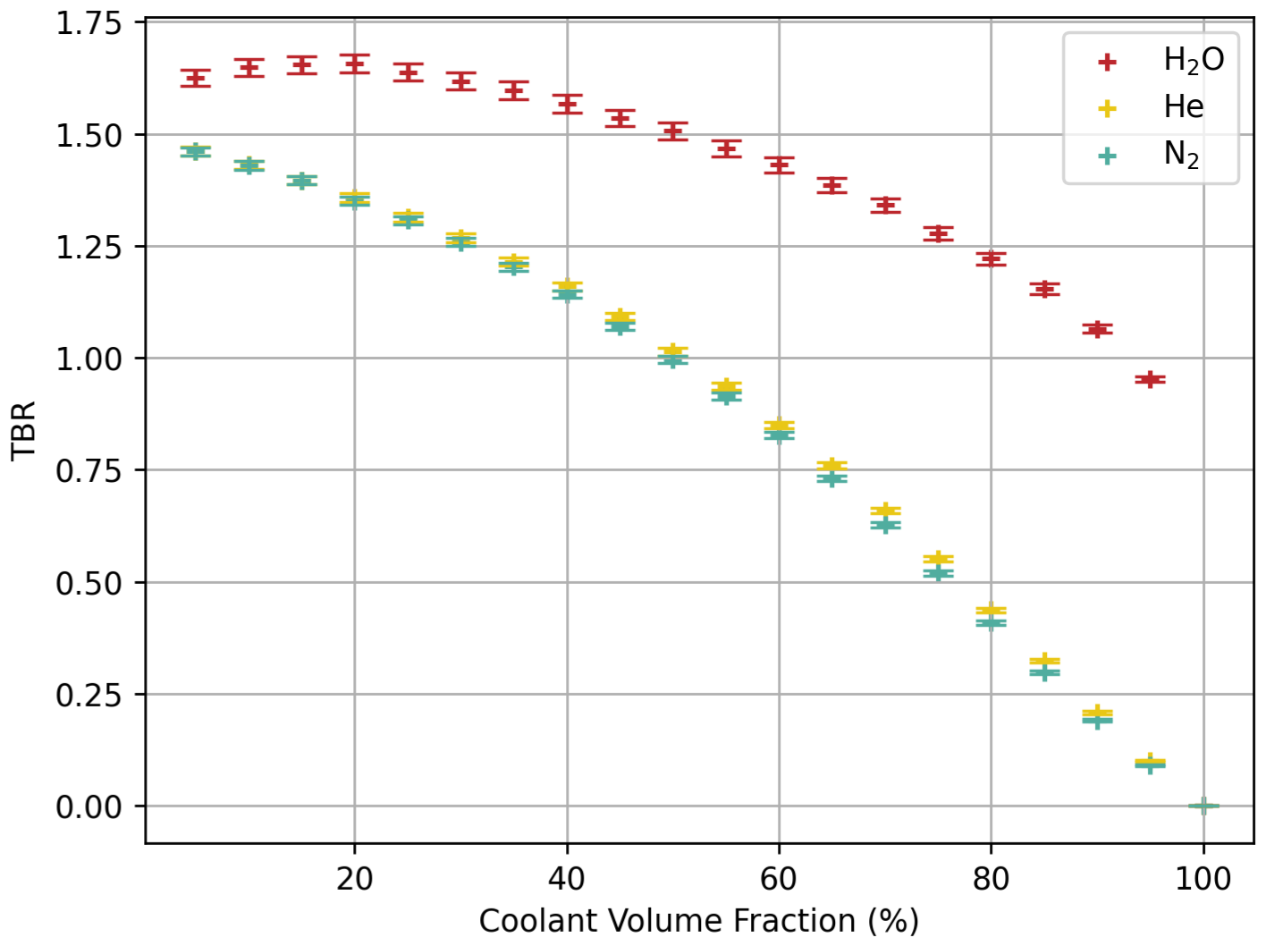
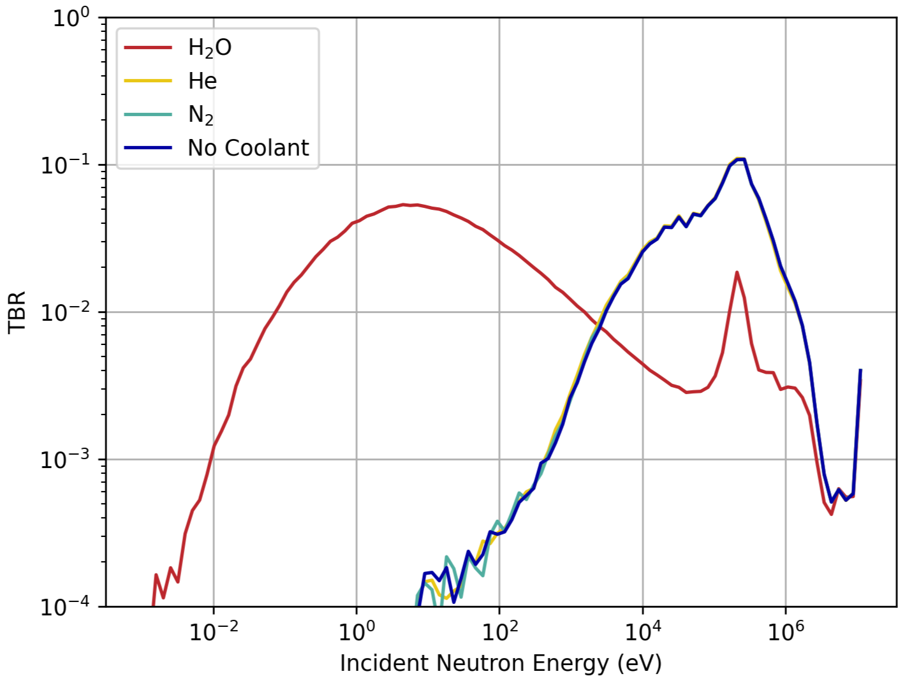
Coolant Materials
TBR / COOLANT FRACTION
TRITIUM BREEDING NEUTRON ENERGY
Water was found to be far superior for TBR as it can act as a moderator.
Lithium and water in close proximity poses a significant safety risk
Must account for the homogeneous approximation

Slide 12
Limitations & Next Steps
Homogenous assumption → Heterogenous blanket upgrade
Plasma ring source → Plasma body source with density variation
Simplified Tokamak geometry → Complex structure more closely matched to real devices
Focus on TBR → Holistic consideration for heating & safety (minimise leakage fractions).

Slide 13
Backup Slides

Slide 14
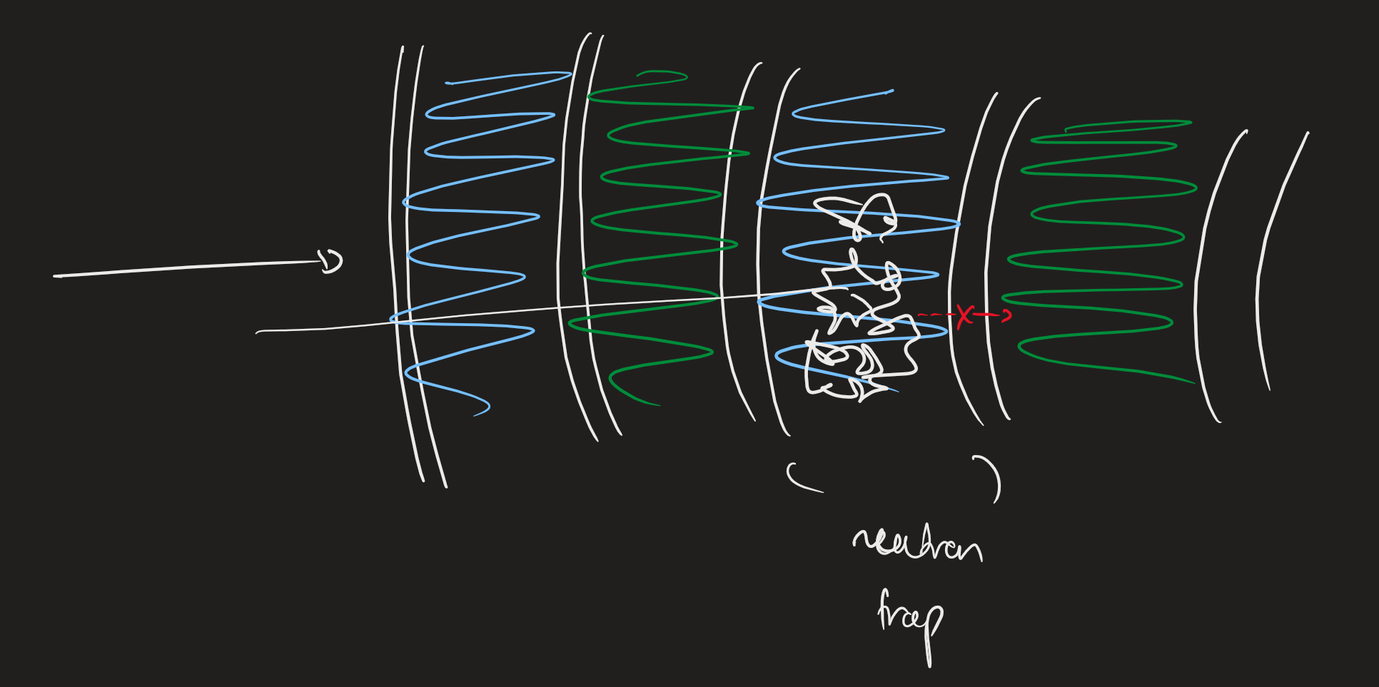
Heterogenous Structure Problems
Unlike Fission, we expect reaction rate / TBR to decrease with heterogeneity, as more barriers from moderation 🡪 breeding are encountered.

Slide 15
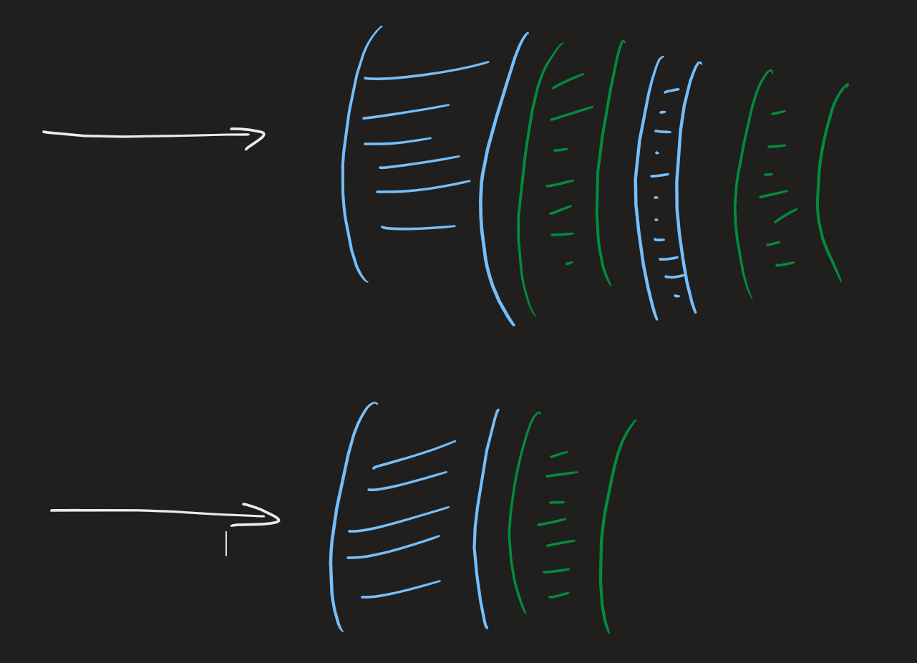
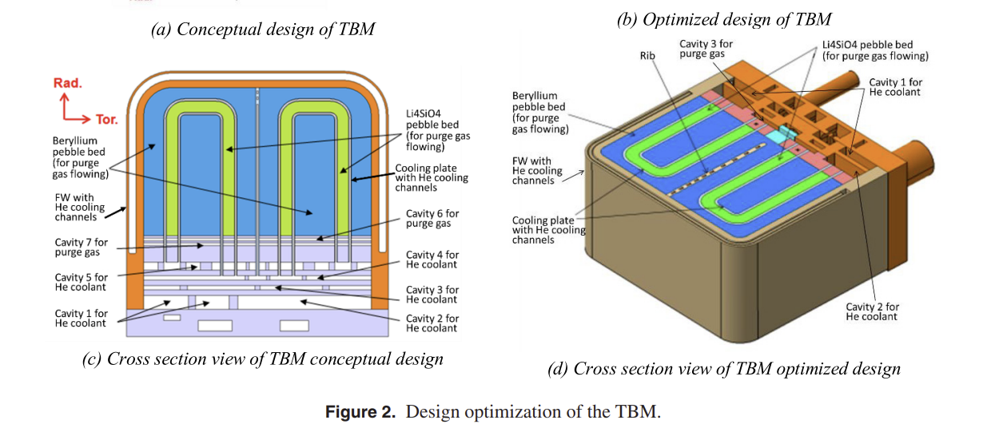
Heterogenous Structure Problems
Optimisation of the multi-layer thicknesses could be non-trivial
Want to have a water layer that is thick enough to moderate but not too thick to fully attenuate
Might want multiple layers for more “realistic” mimicking / avoiding neutron traps.
Real modules (CN HCCB) have piping structures so perhaps different approach required

Slide 16
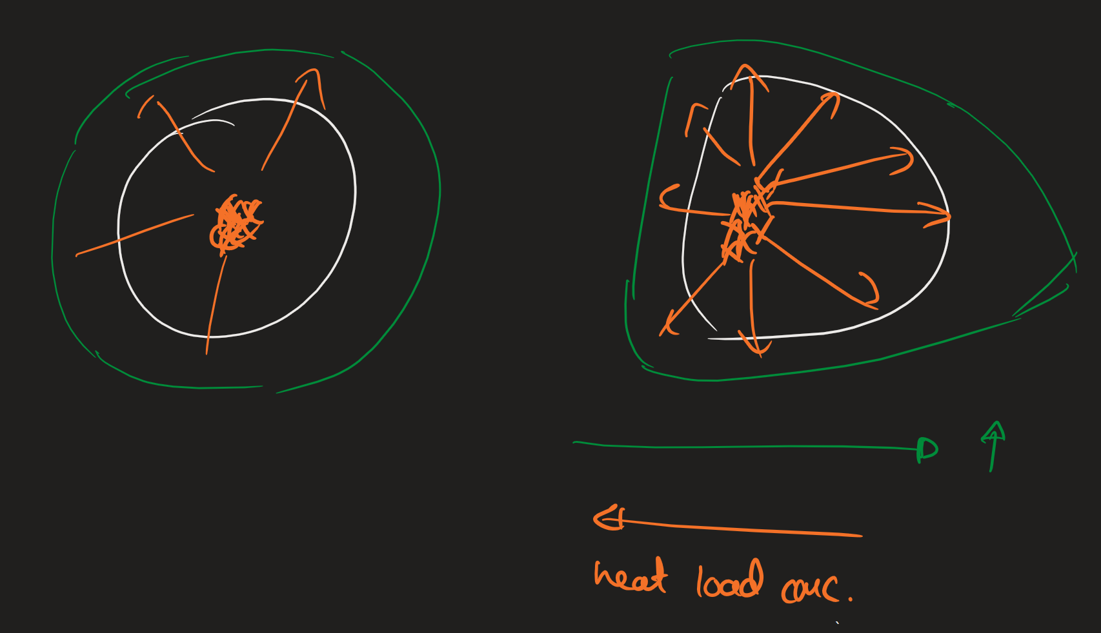
Plasma Body Source
We expect it to introduce asymmetric heat load on different parts of the tokamak
This may increase the TBR if the thickness at all points is at least 500mm (as certain solid angles experience greater geometric thickness)
But it could require varying thickness if below saturation thickness (as the inner walls experience too great a neutron flux)
Also any increases in TBR could be cancelled by the increase in heating management concerns

